Slide 1
Thyroid disorders in children
Dr Sachith Mettananda
Department of Paediatrics
2019

Slide 2
Thyroid gland
Thyroid disorders
Congenital Hypothyroidism
Acquired hypothyroidism
Hyperthyroidism

Slide 3
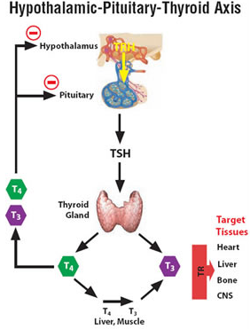

Slide 4
Thyroid gland
Main function
Synthesis of T4 and T3
Thyroid hormones
increase oxygen consumption
stimulate protein synthesis
influence growth and differentiation
affect carbohydrate, lipid, and vitamin metabolism

Slide 5
Congenital hypothyroidism

Slide 6
Epidemiology and Aeitiology
Deficient production of thyroid hormones and manifesting from birth
Incidence – 1:2000 to 1:4000
Causes
Thyroid dysgenesis (85%)
aplasia, hypoplasia or ectopia - Not hereditary
female:male = 2:1
Dyshormonogenesis (15%)
defect in one of the several hormones of thyroid synthesis – Autosomal recessive

Slide 7
Presentation
Detected at Newborn screening –
Clinically asymptomatic at birth due to trans-placental passage of maternal T4
If not screened/detected at birth diagnosis is delayed

Slide 8
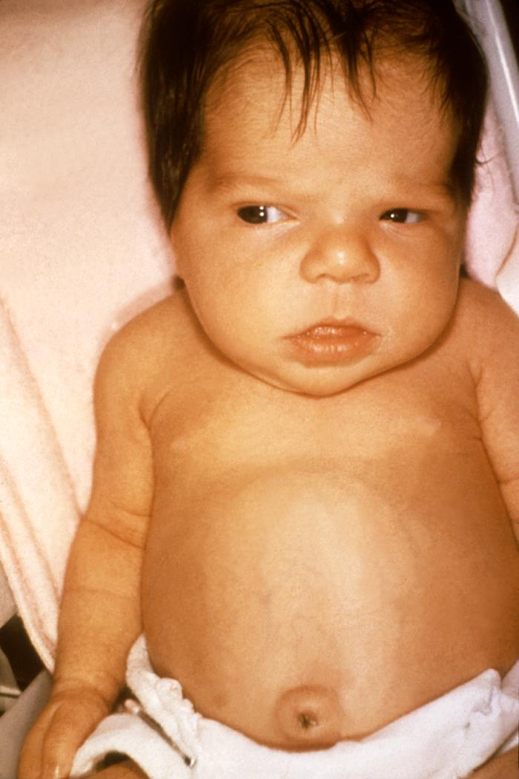
Early clinical features of untreated CH
Widely open AF and PF
Prolonged jaundice – indirect (beyond 2weeks)
Feeding difficulties
Lethargy/sluggishness
Large tongue/ respiratory difficulties
Constipation
Large abdomen/ umbilical hernia
Hypothermia
Bradycardia
Macrocytic anaemia

Slide 9
Associations
10% of infants with CH have associated anomalies
Cardiac
Nervous system
Eye

Slide 10
Untreated CH
Physical and mental development retarded
Develop obvious clinical features by 3-6 months

Slide 11
Late clinical features of untreated CH
Short stature
Developmental delay
Large head/ short neck
Broad hands / short fingers
Dry scaly skin/ coarse scanty hair
Hoarse voice
Hypotonia
Myxedema
Delayed sexual maturation

Slide 12
Laboratory findings
TSH – elevated
Serum T4 and Free T4 – low
Thyroid US scan
Thyroid Scintigraphy - ¹²³I-sodium iodide
X-ray left knee joint
Absent distal femoral and proximal tibial epiphysis / epiphyseal dysgenesis
ECG- low voltage P and QRS complexes

Slide 13
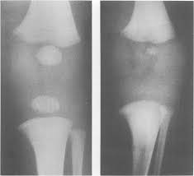

Slide 14
Newborn screening
In operation since 2014 in Sri Lanka
Heel Prick blood sample before discharge OR
Venous blood sample between day 3-5
If Initial TSH is >6mU/L
Do venous TSH/FreeT4 urgently

Slide 15
Treatment
Indications to start treatment
? Low free T4
TSH >20 mU/L (even if free T4 is normal)
TSH between 6-20mU/L and small/ectopic thyroid gland (even if free T4 is normal)
Levothyroxine (L-T4)
Should be started as early as possible
10-15 micrograms/kg/d
Early morning on to empty stomach

Slide 16
Follow-up and monitoring
Monitor treatment with
TSH and freeT4
Free T4 – upper half of the reference range
TSH- in the reference range
Undertreatment – Persistent hypothyroidism
Overtreatment- crainiosynostosis, temperament problems
Thyroid re-evaluation
To identify transient hypothyroidism
At 3 years – gradually reduce and omit LT4

Slide 17
Prognosis
Early diagnosis and adequate treatment from the 1st weeks of life result in normal linear growth and development

Slide 18


Slide 19
Acquired hypothyroidism

Slide 20
Epidemiology and Aeitiology
Incidence – 0.3%
Causes
Chronic lymphocytic (Hashimoto)/ autoimmune thyroiditis
Female > male; familial
Common in Down and Turner syndromes
Autoimmune polyglandular syndromes
Drugs –Amiodarone, lithium, phenytoin, phenobarbitone and valproate
Hypothalamic or pituitary disease – central hypothryroidism

Slide 21
Clinical manefestations
Goiter
Short stature
Weight gain
Cold intolerance, decreased energy, sleepiness
Constipation
Myxedema
Bradycardia
Delayed osseous maturation (bone age)
Delayed puberty

Slide 22
Diagnosis
Free T4 - low
TSH – high (unless central hypothyroidism)
Thyroid US Scan
Antithyroglobulin and antiperoxidase antibodies – in autoimmune thyroiditis

Slide 23
Other laboratory findings
Bone age X-ray- delayed bone age
S. electrolytes- hyponatraemia
S. cholesterol – elevated
Macrocytic anaemia

Slide 24
Treatment
Levo-thyroxine
Monitor with freeT4 and TSH

Slide 25


Slide 26
Graves disease -Hyperthyroidism

Slide 27
Introduction
Autoimmune disorder
Thyrotropin receptor–stimulating antibody binds to and activates the G-protein–coupled thyroid-stimulating hormone (TSH) receptor
Diffuse toxic goiter
Female: male = 5:1
Associated with other autoimmune disorders

Slide 28
Clinical manefestation
Diffuse goiter
Symptoms of hypothyroidism ?
Irritability, hyperactivity, fatigue
Heat intolerance, increase sweating
Increased appetite / weight loss
Diarrhoea

Slide 29
Clinical manifestation
Signs of hypothyroidism
Tachycardia
Fine tremors
Palmer erythema
Hair loss
Eye signs
Exophthalmos
Lid lag and retraction
External opthalmoplegia

Slide 30
Laboratory findings
T4 and free T4 – elevated
TSH – suppressed
Anti-thyroid antibodies - present

Slide 31
Treatment
Anti-thyroid medication
Carbimazole
Prophylthiouracil
Side effects of anti-thyroid drugs
Symptomatic treatment
Beta-blockers (propranolol)
Radio-iodine
Surgery

Slide 32
Summary
Congenital hypothyroidism
Acquired hypothyroidism
Graves disease

Slide 33
You also need to know…
Examination of the thyroid gland
General examination
Examination of the goiter
Examination of thyroid status (eye, hands, etc….)
Thyroglossal cysts
Lingual thyroid

